Slide 1
The Systems Stream
Welcome to Systems at Seneca College

Slide 2
What is a System?

Slide 3
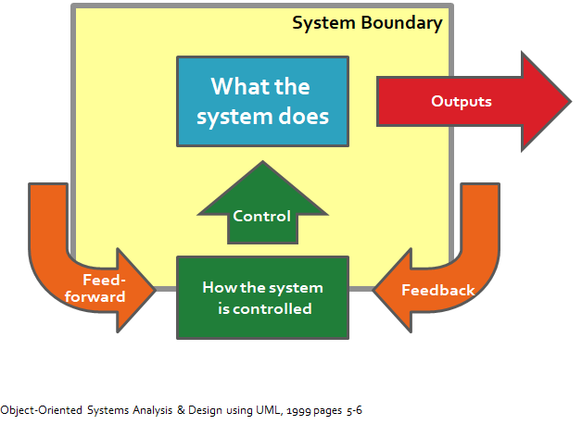
What is a System?
A collection of inter-related components that collect, process and store input to provide as output the information needed to complete (business) tasks.

Slide 4
Characteristics of a System
It exists in an environment
It is separated from its environment by a boundary
It has inputs and outputs which come from, or are sent to the environment
It has interfaces (allows communication between two systems)
It can have sub-systems (which are also systems)
It has a control mechanism

Slide 5

What is a Software System?
A combination of hardware and developed software that creates the solution to solve a problem or meet the needs (of a business)

Slide 6
What is Software Development?
Software Development implies developing some software
Does not involve simply coding programs
Software is developed:
to turn manual processes into automated processes
to improve/enhance existing automated processes.

Slide 7
What does this have to do with Systems?
Software Development entails understanding:
how a business operates
the problem to be solved
that the solution to be developed will be of value to the business

Slide 8
Why Develop Software?
Environments are rapidly changing
New Operating Systems, changes to office workspaces
New technologies are frequently introduced
Touch, speak, cloud, AR, VR… what’s next?
Companies merge and need to combine their systems
Combine two separate database systems
Governments pass new legislation or make changes to it
New tax codes

Slide 9
Typical Software Development Solutions
Customized
Developed in-house
Contracted out
Off-the-Shelf
Turnkey
Combination
Off-the-Shelf software with custom components
Customized Software with Off-the-Shelf components
There are Pros and Cons to each type of solution!

Slide 10
What you will learn in the Systems Stream

Slide 11

Systems Analysis
What goes into a system?
How do we determine what needs to be built?
Who is involved with these decisions?

Slide 12

System Design
How will our system work?
What is the ‘flow’ of input and output?
How does the user’s interaction affect the system’s behaviour?
What will the system look like?
How will data be stored?

Slide 13
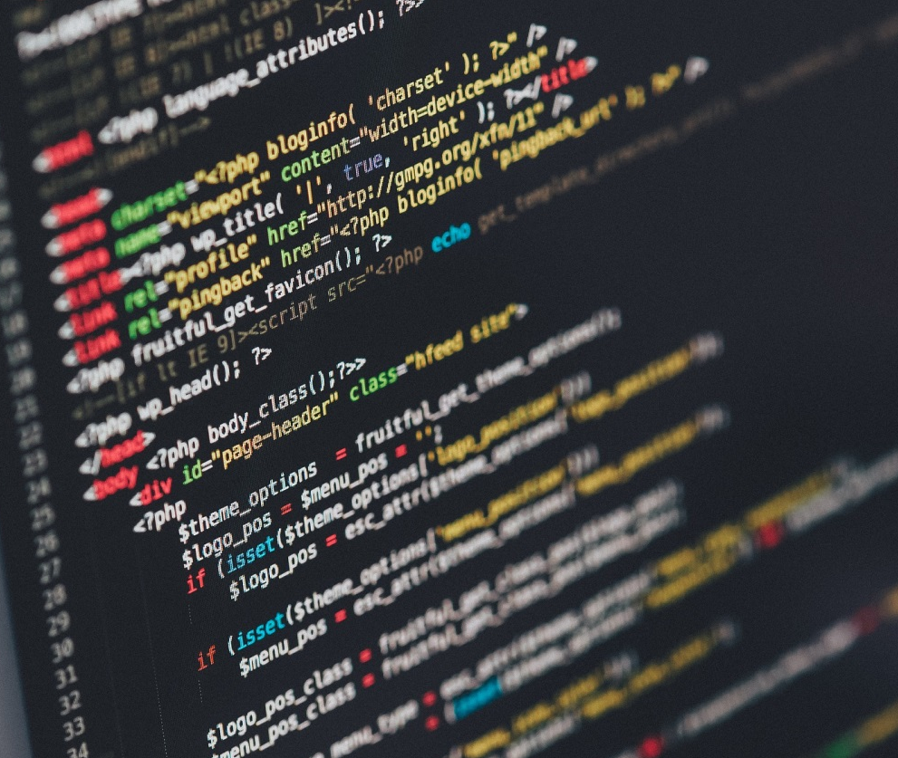
System Development
Build the system
Create documentation
Test
Maintain

Slide 14
Systems Stream of Subjects
Gives CPA students the experience of completing the SDLC using object oriented project management design techniques

Slide 15
Systems Stream – SYD366
Experience the difference between Predictive and Agile Project Management methodologies
Follows a small business through selection of software
Build Class and Sequence Diagrams by reviewing User Stories (Agile artifacts) and Systems Use Case Specifications.
Research off the shelf software solutions and determine the best fit.

Slide 16
Systems Steam – SYD466
Follows a medium to large business through the design of software
Utilize advanced Modelling techniques
Write User Stories (Agile artifacts) and Systems Use Case specifications from a case study.
Complete a response to a request for Proposal

Slide 17
System Steam – PRJ566
Using the knowledge acquired in the SYD366 & SYD466, Start developing a solution to solve a real life problem
Design and plan the implementation of the solution in a group environment

Slide 18
System Stream – PRJ666
Code and test the implementation of the developed solution previously developed in the PRJ566

Slide 19
The SDLC
The Systems stream of courses provide the knowledge of the steps that need to be followed to successfully create a software solution from the inception of the idea to a working, fully operational system

Slide 20
System Stream - completes SDLC
This collection of steps is called the Systems Development Life Cycle.
By the time that you have completed the 4 courses comprising the Systems Stream in CPA, you will have experienced the SDLC using Agile methodologies and artifacts

Slide 21
System Stream prepares you for the Role of the Systems Analyst
An IT professional involved in the development of a computerized solution to a business problem
Requires extensive technical, business and people knowledge, communication, businessand technical skills
Is fundamentally curious to explore how things are done with a desire to make them workbetter
Focuses on understanding the business problem
Focuses on the approach to be taken to solve the business problem
Meeting and managing deadlines

Slide 22
Systems Analyst Skills
Technical Knowledge and Skills
Business Knowledge and Skills
People Knowledge and Skills
Integrity & Ethics

Slide 23
Job Prospects for a Systems Analyst
Indeed.ca

Slide 24
How to get a good grade in SYD366?
Participate
Read
Research

